Slide 1
Singal Factor-Based Investment Strategy of S%P 500 index
Group 15
Presenter : SUN Yuan

Slide 2
Introduction
Definition of Factor-Based Investing:Factor-based investing refers to the strategy of using specific publicly available factors (or attributes) to explain asset returns and construct portfolios aiming to achieve excess returns. These factors include value, momentum, size, and quality.We chooose momentum since It is easy to understand, implement, and is often used in trading strategies in the real market. We can use the past 12 months' returns as factors and test their ability to predict the returns of the next 1 month.
Importance in Asset Management: Factor-based investing strategies provide a systematic approach to identifying and capturing market opportunities through quantitative analysis, aiming to enhance risk-adjusted returns and reduce subjectivity in the investment process.

Slide 3
Data Description
Data Sources: S&P 500 historical price data from 2019-2024 is sourced from Yahoo Finance, with fundamental data including open, high,low, cloesed price and volume with adjusted price.
Data Preprocessing:Missing values are handled using forward filling or interpolation methods to ensure data continuity and completeness.Data normalization is performed to ensure comparability across different periods.

Slide 4
Key indicators
Adjusted closing price
Daily return (calculated using log returns)
Momentum indicator: rate of price change over the past 252 trading days

Slide 5
Factor Logic
Definition:Momentum reflects the price trend of stocks over a specific period.
Momentum Hypothesis: Stocks that performed well in the past tend to continue performing well.
Investors tend to favor consistently rising stocks, resulting in the "trend continuation phenomenon."Investor sentiment and behavior often lead to trend-following, exacerbating price movements.

Slide 6
Strategy Design
Universe: Composed of S&P 500 stocks, which covers the largest 500 companies in the market, ensuring high liquidity and representativeness.
Rebalance Frequency:Monthly rebalancing using monthly data for risk control and dynamic adjustment.
Neutrality:Aim to achieve neutrality by diversifying asset selection to mitigate excessive exposure to any single factor.Equal-weighted portfolio within groups and No sector constraints applied for risk control purpose.

Slide 7
Back-testing Performance
Backtesting method: Analyze the effectiveness of the momentum factor using historical data, obtaining performance metrics through monthly returns and momentum indicators.
Metrics Evaluated:Annualized Return, Risk-adjusted Return (Sharpe Ratio),Hit Rate (percentage of positive returns),Turnover Rate and Information Coefficient (correlation between factor and future returns).

Slide 8
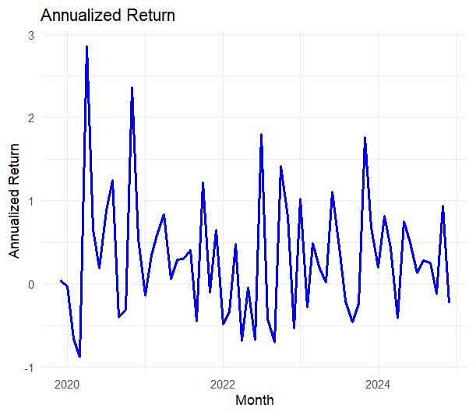
Annualized Return
In periods of good performance, the strategy performed exceptionally well, capturing the upward trend in a strong market.
COVID-19 effect

Slide 9
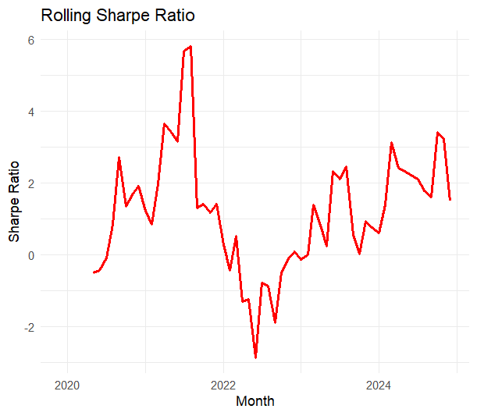
Risk-adjusted Return
In periods of poor performance, the market experienced increased volatility, and the strategy failed to adjust effectively, leading to a breakdown of momentum signals.
Momentum strategies may encounter reversals in uncertain market conditions, resulting in losses.

Slide 10
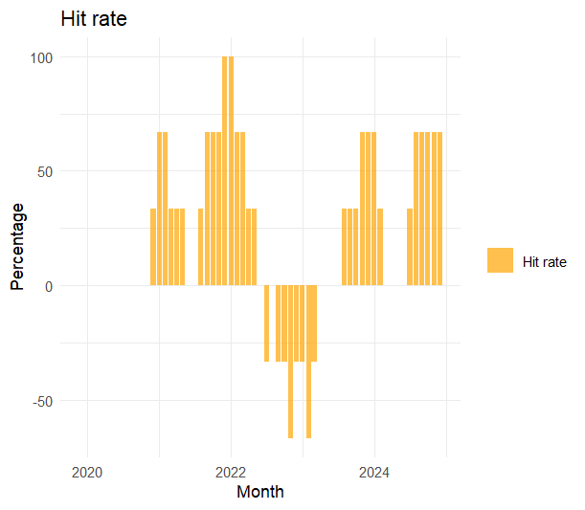
Hit Rate
% of stocks outperform the benchmark for in the basket
Measure the breath of the signal
We set benchmark = 0.
Portfolio outperformed benchmark(positive).
The portfolio performance is lower than the benchmark(negative).
A high hit rate indicates that the strategy is successful, while a low hit rate may need to be adjusted.

Slide 11
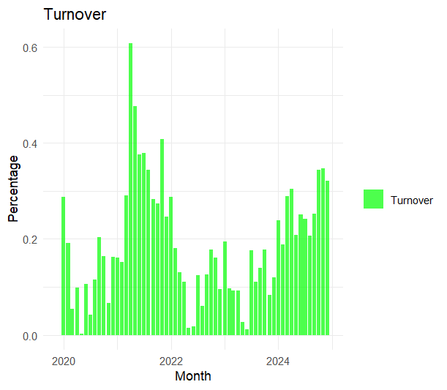
Turnover
% of stocks are changed in the portfolio per annum
Higher the turnover, higher the transaction cost

Slide 12
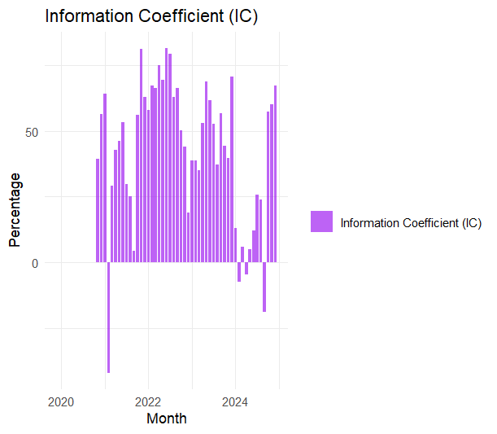
Information Coefficient
Rank correlation between the signal and subsequent period returns
Measure the prediction power of the signal, the IC value typically ranges from -1 to 1; the closer to 1, the stronger the predictive power of the signal.
indicates a positive correlation between the signal and subsequent returns, suggesting the signal can effectively predict future gains.
Indicates a negative correlation between the signal and subsequent returns, suggesting poor predictive power of the signal.

Slide 13
Strategy Failure Analysis
Weak Periods:
  Market condition changes: Momentum strategies often perform well in trending markets but may fail in choppy or directionless markets.
  Changes in investor behavior: Market sentiment shifts and popular investment styles can affect the effectiveness of momentum factors.
  Complexity of the model: Less complexity and risk filter.
Potential Improvements: Continuous adjustments and optimizations are needed to improve adaptability and robustness. Like Adding a risk filter (e.g., volatility adjustments).

Slide 14
Conclusion and future work
Conclusion:The momentum factor performs excellently in specific market environments but requires cautious application. In other words, Momentum is an effective strategy, but has its risks.
Future work:
  Consider integrating other factors (such as value, low volatility) for improved performance.
  Conduct in-depth research on how market changes impact factor performance to optimize strategy design.
  Explore multi-factor models for better risk management.

Slide 15
Thank you

